Slide 1
Can a social intervention in the classroom impact obesity?
Results of a randomized controlled trial
Amanda W. Harrist, Julie M. Rutledge, Taren M. Swindle, Laura Hubbs-tait, Lenka h. shriver, and glade L. topham

Slide 2
How to CitE
Harrist, A. W., Rutledge, J., Hubbs-Tait, L., Shriver, L., Swindle, T., & Topham, G. (2017, April). The peer experiences of severely obese, obese, and overweight school children. In M. Bookhout (chair) and M. Prinstein (discussant), The positive and negative roles of peer relations in childhood obesity. Paper presented in symposium at the biennial meeting of the Society for Research in Child Development, Austin, TX, United States.

Slide 3
Childhood obesity – more than physical health risks
Obesity is currently the most common health problem among US children.
Besides the physical health implications implicit with obesity, overweight and obese children are at an increased risk of peer problems in school environment, such as:
Teasing
Rejection
Bullying
Severely obese children may be at a particular risk.

Slide 4
Biases toward obesity
Less likely to be picked as a friend
Receive negative descriptions like “mean” or “lazy”
Viewed more negatively than physical disability

Slide 5
Why are peer relations important?
Early Childhood:
Marked by enjoyed play and sharing.
Middle Childhood:
Mutual trust is defining feature.
Adolescence:
Intimacy and loyalty are most valued.
Trajectory of peer relations across childhood:
Part of peer relations is acceptance.

Slide 6
acceptance
The need to be accepted is a basic human need.
Being part of a group keeps us safe.
Belonging is part of identity.
We want to be accepted by: Authority figures, people with status, people we want as friends.
Yet, it’s human nature to reject or ostracize people – rejection happens all the time.

Slide 7
Peer status in the classroom
Sociometric Nominations - Children nominate three friends with whom they like to “play with the most” and “play with the least.”
Many liked
Controversial
Popular
Rejected
Neglected
Many disliked
Few disliked
Few liked

Slide 8
Peer Status Outcomes
CONTROVERSIAL
Substance Abuse
Conduct Problems
Attention Problems
Court Offences
Grade Failures
POPULAR
Comparison Group
REJECTED
Substance Abuse Aggression
Attention Problems Court Offences
Conduct Disorders Grade Failures
External Locus of Control
School Drop Out
NEGLECTED
External Locus of Control
Less Peer Support

Slide 9
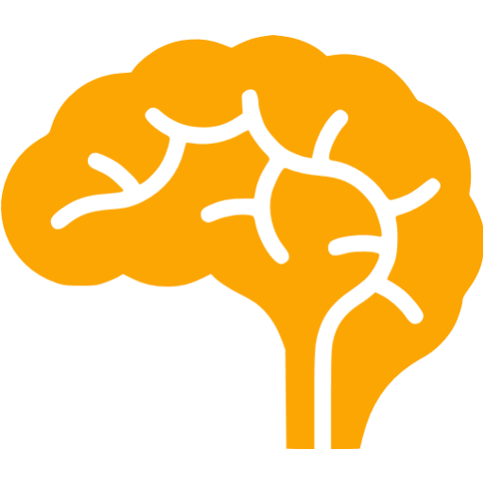
rejection
Research among elementary children predicts concurrent and future problems.
Rejected children are more likely to:
Be lonely, depressed
Become withdrawn, aggressive, and/or delinquent
Poor attendance, avoid school
Have trouble learning
Recent research has shown that the brain reacts to social rejection in the same way it does to physical pain.

Slide 10
Rejection in the classroom
Children tend to be disliked/get rejected because:
They are aggressive
OR
They are “different”
Ethnic minority
“Funny looking”
Have a disability
Are overweight
Child Weight
Peer Status
Academic
Social
Self-Competence
Outcomes

Slide 11
Rejection, self-esteem, health – a vicious cycle
Obesity
Rejection
Negative feelings about self and life
Unhealthy Eating Behaviors

Slide 12
Classroom based interventions
Previous interventions have:
Targeted rejected children
Pulled them out of class and taught social skills
But what happens when they return to the same environment with the same children?

Slide 13
Families and schools for health peer group intervention
Focuses on creating a SAFE environment where children are ACCEPTED so they can focus on the important tasks of childhood like:
Play
Friendship
Learning
Growing
…by normalizing a culture of acceptance and inclusion.
We have rules at school saying ‘you can’t hit’ and ‘raise your hand before you speak.’ Why not create a rule saying ‘you can’t reject?’

Slide 14
Method - overview
29 rural schools were randomized to intervention (n = 599) or control (n = 615) conditions during the children’s 1st grade year.
The sample was low-income and rural and are at an increased risk for obesity.
65% on free/reduced lunch
All but 2 towns had a population of less than 10,000
Majority of the sample was European- or Native-American
Anthropometric assessments (height, weight) were conducted at school pre-test (winter of 1st grade), post-test (end of 1st grade), and each spring in 2nd, 3rd, and 4th grades.
Obese (BMI ≥ 95%) = 181
Overweight (85% ≤ BMI < 95%) = 200
Healthy Weight (BMI < 85%) = 759

Slide 15
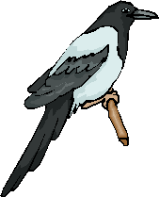
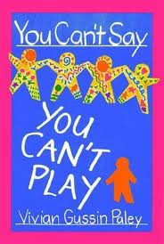
You can’t say, ‘you can’t play’
Based on Vivian Paley’s 1992 book
5 components:
Introduce the You Can’t Say, ‘You Can’t Play Rule’ to the classroom
Read The Kingdom of Tall Pines fairytale and lead discussions
Role play real-life scenarios and practice using the rule
Don’t Laugh At Me
Make Your Own Magpie
Peer Group Interventionists met with each 1st grade class in each peer group school (11 schools, 33 classrooms) 12 times.

Slide 16
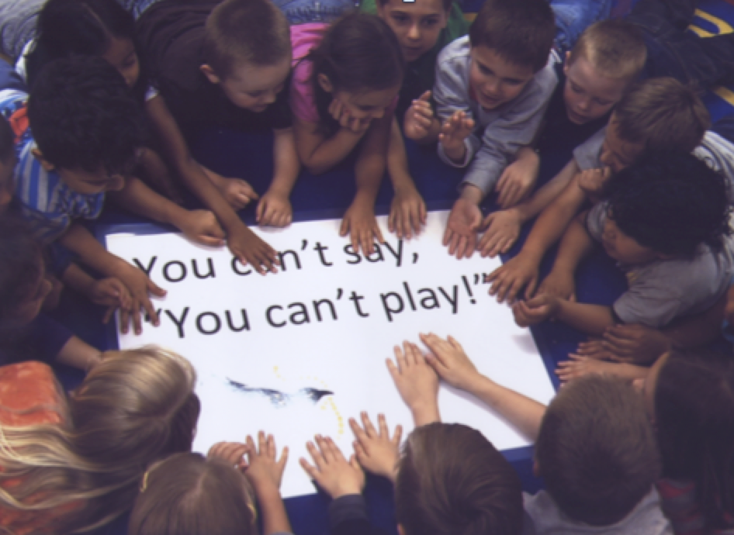
Component 1 – introduce the rule
After introductions, hold a discussion about rules
What are some rules you have in your class?
What kind of rules do you have at home?
Why do we have rules?
Leading the discussion to this key point → Schools and families have rules because they want you to be healthy and safe and not get hurt.
Then bring up the point, there’s another way to get hurt…feelings.
Some rules, like taking turns, sharing, not calling each other names, help us get along with others.
One thing that really hurts is being left out – have you ever been left out?
Today, we’re adding a new rule to your classroom…

Slide 17
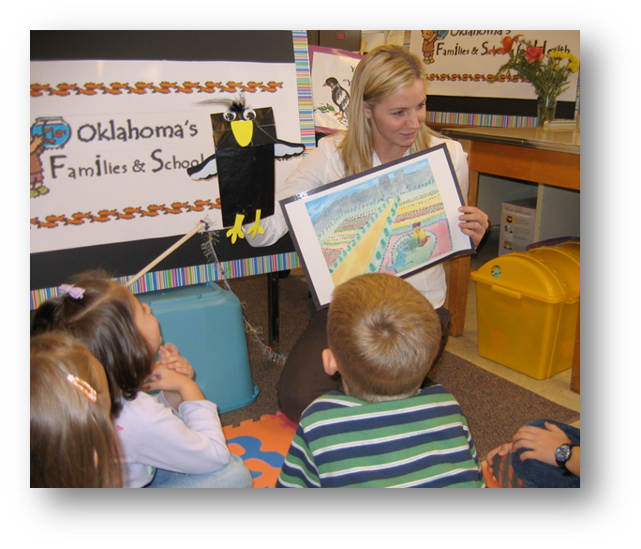
component 1, cont.
Introduction of Magpie
Magpie is a new friend who is going to help us learn about the rule.
Magpie tells the class he is from The Kingdom of Tall Pines
Tell the class that we’re going to read a story about Magpie’s adventures in the Kingdom of Tall Pines over the next few weeks when we come back.

Slide 18
Component 2 – fairytale and discussions
5 sessions devoted to reading segments of The Kingdom of Tall Pines and leading group discussions about the story and how the story relates to our new classroom rule – YCSYCP
DISCUSSION QUESTIONS:
Why did the tiny orange flower people need Annabella and Magpie’s help? [A golden eagle stole their baby, Prince Orange Flower.]
How did Magpie trick the eagle? [Uncle Orangerio flew on his back and hid in the nest; Magpie imitated the eagle’s sound and distracted him.]
What was Magpie’s special talent? [imitation]
What was Uncle Orangerio’s special talent? [being small]
LINK TO YCSYCP RULE:
Magpie and the flower people helped each others. That’s what friends do for each other, isn’t it? Remember our rule, You can’t say, ‘You can’t play’? We want you to have that rule in your class because when people play together, they can be friends and help each other like Magpie and Uncle Orangerio did.
Always end by asking about use of the rule in the classroom since the last time we were there.

Slide 19
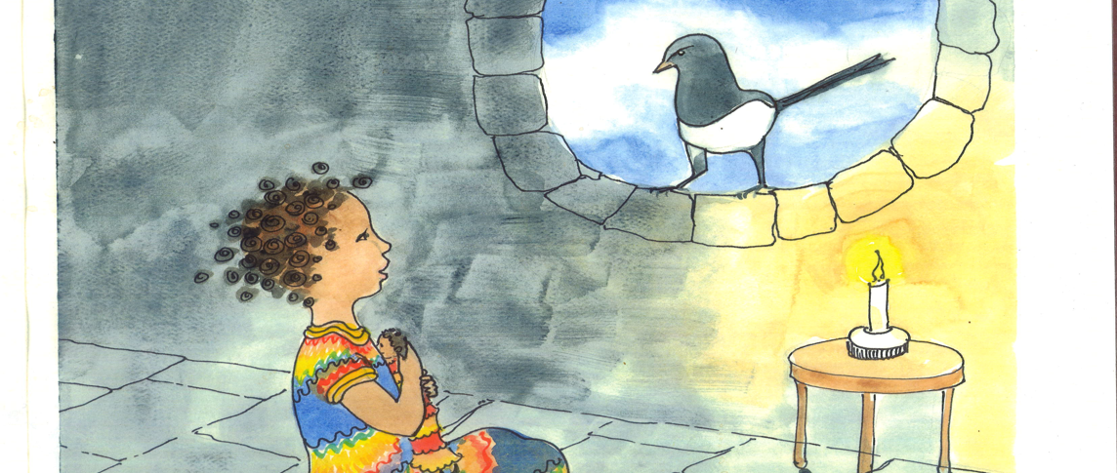

Slide 20
Component 3 – role play and rule practice
Each visit included 4 segments:
Troubleshooting
-Review rule
-Repeat rule
-Successes
-Opportunities for improvement
Role Play
-At least 2 but try to do 3 per visit
-Try to get children to figure out the ‘moral of the story’ on their own through: questioning, scaffolding, and guided questions.
Conclusion
-Thank everyone
-Say the rule again
-Link it back to the fairytale by having Magpie present, especially at the end to say goodbye
Transition
-Reminders about role play
-Using the remote and what the buttons mean

Slide 21
Component 4 – don’t laugh at me
Troubleshoot YCSYCP rule
Listen to the song (CD) while showing the book
Play it again and ask them to think about YCSYCP
Guided discussion about the characters from the book
Who had the saddest story?
Why were the children in the book being laughed at?
Linking it to our program: What does this have to do with our You Can’t Say, ‘You Can’t Play’ rule?
YCSYCP means giving everybody a chance; if you laugh at somebody, you’re probably not playing with them or giving them a chance; if you laugh at somebody because of how they look, you’re not being fair, and the rule is about being fair.

Slide 22
Component 5 – make your own magpie
Fun art activity that lets the children take home their own reminder of the program.
Bye-Bye!

Slide 23
Intervention evaluation
Focus on linking intervention to children’s health status as measured through BMI
In addition to the Peer Group (PG) Intervention, the overall program had two family-based interventions both of which had 12 sessions that were 90 minute psychoeducation groups.
The Family Lifestyle (FL) Intervention focused on healthy eating.
The Family Dynamics (FD) Intervention focused on family socioemotional issues.
PG+FL
3 schools
PG+FL+FD
8 schools
FL or FL+FD (non-PG)
13 schools
Control
5 schools
Randomized-Controlled-Trial Design with stratification based on community size, school size, and proportion of children in free or reduced-price lunch programs.

Slide 24
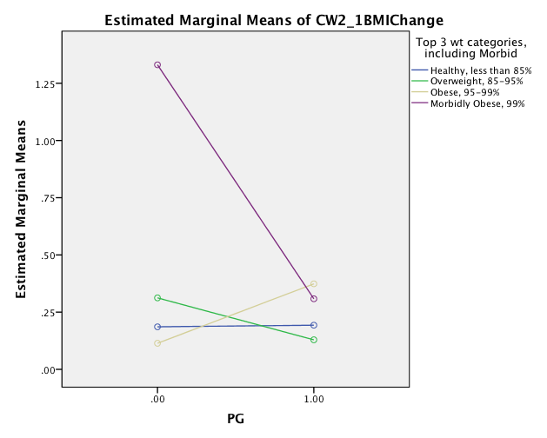
results
BMI-change scores (difference from pre-test) were computed per wave.
Four 2(PG, yes/no) x 4 (weight status) ANOVAs were computed (BMI-change = DV)
At post-test, effects of PG, weight status, and their interaction were significant.
F_{PG}(1, 1068) = 6.50, p = .01;
F_{weight}(3, 1068) = 6.95, p <.001;
F_{PGxWeight}(3, 1068) = 5.80, p = .001.
Interaction of Pre-Test Weight (BMI-for-age) and PG Status (1=PG Intervention occurred, 0 = PG Intervention did not occur) at 1st Grade Post Tests, with Change-in-BMI as Outcome Variable. Estimated marginal means are graphed.

Slide 25
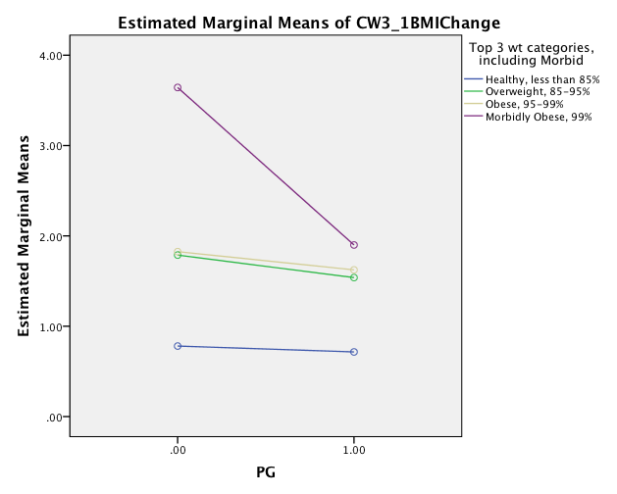
Results – longitudinal
Findings were sustained at both 2nd (see figure):
F_{PG}(1, 936) = 17.00, p <.001;
F_{weight}(3, 936) = 51.85, p <.001;
F_{PGxWeight}(3, 936) = 5.77, p = .001
…and…
Interaction of Pre-Test Weight (BMI-for-age) and PG Status (1=PG Intervention occurred, 0 = PG Intervention did not occur) at 2nd Grade Post Tests, with Change-in-BMI as Outcome Variable. Estimated marginal means are graphed.

Slide 26
Results – longitudinal
…3rd grade:
F_{PG}(1, 758) = 16.91, p <.001;
F_{weight}(3, 758) = 53.39, p <.001;
F_{PGxWeight}(3, 758) = 4.13, p = .006
Where interactions were observed, the PG intervention had the greatest effect on severely (morbidly) obese children.

Slide 27
Independent effect of pg intervention
The independent effect of the PG intervention (above-and-beyond FL and FD intervention effects) was examined via regression.
The PG intervention was found to uniquely predict a significant decrease in BMI% relative to controls in both 2nd and 3rd grades.
 | 1st Grade, Post-Test |  | 2nd Grade |  | 3rd Grade |  | 4th grade
 | β | p | β | P | β | p | β | p
FL | -.06 | .02 | .00 | -- | -.02 | -- | -.12 | --
FL+FD | -.03 | -- | .01 | -- | -.03 | -- | -.20 | .03
PG | -.01 | -- | -.06 | .05 | -.09 | .02 | -.01 | --
Note: A negative Beta indicates a greater decrease in BMI% from 1st Grade Pre-Test than was the case for Controls. Boldface font highlights PG effect above and beyond FL and FL+FD.

Slide 28
implications
Targeting social relations at school may be crucial
to promoting health for young children,
particularly those in the highest weight category.

